Slide 1





Crash course on pandas
Slides by Sammy Klasfeld
(Please sign-in on the counter near the back door)
Sponsored by:
Notes:
Thanks so much to BGS,IBI, and GCB for sponsoring this year's bootcamp! Thank you to Sarah Middleton for creating and making this workshop possible. This workshop is is run by students who are juggling research and volunteering so I apologize in advanced and thank everyone for their patience. There will be two lecturers: Apexa and Scott and handful of TA that will be providing help through out the course.
http://upibi.org/

Slide 2







Today’s TAs
Apexa
Sammy
Ben
David
Will
Jake
Parisa

Slide 3
Argparse Comments (Lab 6)
I made a mistake. In the last class, I distinguished two types of arguments:
Positional arguments
Optional arguments
python filename.py -x 5 --color red 5 apple
File
name
Optional arguments
Positional arguments

Slide 4
Argparse Comments (Lab 6)
I made a mistake. In the last class, I distinguished two types of arguments:
Positional arguments
Optional arguments Flag arguments:
Default to optional arguments, but can be set to required
python filename.py -x 5 --color red 5 apple
File
name
Optional arguments
Positional arguments
FLAG ARGUMENTS

Slide 5
Argparse Comments (Lab 6)
There are two types of arguments: positional and flag

Slide 6
Argparse Comments (Lab 6)
There are two types of arguments: positional and flag
Usually, if you use argparse to organize your arguments in a script:
your flag arguments can go in any random order before or after the positional arguments.
You just need to make sure you put the positional arguments in the correct order.

Slide 7
Argparse argument order
madlibs.py
import argparse
parser=argparse.ArgumentParser(description= \
"fill in a madlib")
parser.add_argument('move_by_p1',
choices=['rock', 'paper', 'scissors'],
help="person1 choice of rock, paper, or scissors")
parser.add_argument('move_by_p2',
choices=['rock', 'paper', 'scissors'],
help="person2 choice of rock, paper, or scissors")
parser.add_argument("--names","-n", type=str,
nargs=2, required=True, help="Two \
peoples name. They cannot be the \
same name.")
parser.add_argument("--ages","-a", type=int, nargs=2,
required=False, help="Two peoples age.")
args=parser.parse_args()
These commands are all equal:
> python madlibs.py -a 42 3.14 -n Sheldon Karen paper rock
> python madlibs.py -n Sheldon Karen -a 42 3.14 paper rock
> python madlibs.py paper rock -a 42 3.14 -n Sheldon Karen
> python madlibs.py paper rock -n Sheldon Karen -a 42 3.14
These commands are all equal, but different from above:
> python madlibs.py -a 42 3.14 -n Sheldon Karen rock paper
> python madlibs.py -n Sheldon Karen -a 42 3.14 rock paper
> python madlibs.py rock paper -a 42 3.14 -n Sheldon Karen
> python madlibs.py rock paper -n Sheldon Karen -a 42 3.14

Slide 8
Argparse Comments (Lab 6)
There are two types of arguments: positional and flag
Usually, if you use argparse to organize your arguments in a script:
your flag arguments can go in any random order before or after the positional arguments.
You just need to make sure you put the positional arguments in the correct order.
WARNING: if you use nargs="*" or nargs="+" in either your positional or optional arguments, you may need to test your script to see which works.

Slide 9
Argparse argument order
Be careful if you set nargs to ‘*’ or ‘+’
test1.py
import argparse
parser=argparse.ArgumentParser()
parser.add_argument('pos_1', help="a string")
parser.add_argument('pos_2', help="a string")
parser.add_argument("--option_1","-o1", type=str,
nargs="*", help="list of strings")
args=parser.parse_args()
If you set nargs="*" in flag arguments you must put positional arguments before the flag aguments
> python test1.py -o1 op1 pos1 pos2
test1.py: error: the following arguments are required: pos_1, pos_2
The following works correctly:
> python test1.py pos1 pos2 -o1 op1
If you set nargs="*" in positional arguments things get tricky since python cannot distinguish between the position anymore which variable goes where. Therefore, if I want a list argument, I will use a flag argument and set `required=True`

Slide 10

What we need for today’s class
Pandas and NumPy installed
Notes:
Numpy is the “fundamental package for scientific computing in Python”
It provides a context for mathematical operations in python to improve speed of calculations
Further explanation is beyond the scope of the course, but we use some of its functions for this lecture.
https://docs.scipy.org/doc/numpy-1.13.0/user/whatisnumpy.html

Slide 11
Today’s schedule
Introduction to Pandas
Creating a pandas dataframe
Selecting an index or column from a pandas dataframe
Writing pandas dataframes to a file
Updating DataFrames
Creating new rows/columns
Dropping rows/columns
Sorting Columns/Rows
Applying Functions to Columns/Rows/Values in a dataframe
Combining DataFrames together
Grouping Rows in DataFrames

Slide 12
1. Introduction to Pandas

Slide 13
What is pandas?
Pandas is a python module that is capable of working with structured data fast, easy, and expressive
Pandas introduced two data structures:
Series
DataFames

Slide 14
Series Data Structure
Series are 1-dimensional data table
You can think of a series as:
A list
A dictionary
A single row
A single column
An array

Slide 15
Series Data Structure
Series are 1-dimensional data table
You can think of a series as:
A list
A dictionary
A single row
A single column
An array
 | Column A | Column B
Row1 | <value_A1> | <value_A1>
Row2 | <value_A2> | <value_A2>
Column A is an example of a series with indexes: [Row1, Row2].
Column B is another series with the same indexes.

Slide 16
Series Data Structure
A series is a pandas 1D object s= pd.Series([1,2,3,4,5])
Contains an array of data: strings, floats, ints, etc
Has an associated array of data labels called the index which correspond to the values in the series
By default the index is from 0 to n-1, where n is the length of the index (similar to a list)
However, the indexes can be set to strings (similar to keys in a dictionary)

Slide 17
Series Data Structure
# create series
import numpy as np
import pandas as pd
s = pd.Series(
[5,3,6],
['a','b','c'])
print(s)
Here we set the values of the series to these numbers.
These are the indexes of our series
a -0.039967
b 1.553495
c 1.909751
dtype: float64
Note that every series has a “dtype” which corresponds to the data-type of its values

Slide 18
Series Data Structure
Values in a series can be retrieved by either the location in the series (like a list) or their index value (like a dictionary)
>>> s = pd.Series([5,3,1],['a','b','c'])
>>> # return the first value of the series
>>> s[0]
5
>>> # return the value corresponding to index 'b'
>>> s['b']
3

Slide 19
Series Data Structure
Values in a series can be retrieved by either the location in the series (like a list) or their index value (like a dictionary)
>>> s = pd.Series([5,3,1],['a','b','c'])
>>> # return the first value of the series
>>> s[0]
5
>>> # return the value corresponding to index 'b'
>>> s['b']
3
Warning: if the items in the index are ints then items are only retrieved by their index values
>>> s = pd.Series([5,3,1],[1, 2, 3])
>>> s[1]
5

Slide 20
Series can be converted to/from lists or dictionaries
# create series from list
>>> list_x = [1,2,3]
>>> series_x = pd.Series(list_x)
>>> series_x 0 1
1 2
2 3
dtype: int64
# convert series to list
>>> series_x.to_list()
[1,2,3]

Slide 21
Series can be converted to/from lists or dictionaries
# convert dictionary to series
>>> dict_y = {'a':1,'b':2,'c':3}
>>> series_y = pd.Series(dict_y)
>>> series_y
a 1
b 2
c 3
dtype: int64
# convert series to dictionary
>>> dict(series_y)
{'a': 1, 'b': 2, 'c': 3}
# create series from list
>>> list_x = [1,2,3]
>>> series_x = pd.Series(list_x)
>>> series_x 0 1
1 2
2 3
dtype: int64
# convert series to list
>>> series_x.to_list[]
[1,2,3]

Slide 22
Functions with Pandas Series
print(s)# series
# apply abs function
# to each item in series
s.apply(abs)
b -1.197346
a 0.295999
c 0.094600
dtype: float64
b 1.197346
a 0.295999
c 0.094600
dtype: float64
# add series element-wise
print (s + s)
b -2.394692
a 0.591998
c 0.189200
dtype: float64
# get mean of total Series
s.mean()
-0.2689156801441579

Slide 23
A DataFrame is a Virtual Table
 | Column A | Column B | Column C
Row 1 | value or NaN | value or NaN | value or NaN
Row 2 | value or NaN | value or NaN | value or NaN
Row 3 | value or NaN | value or NaN | value or NaN
Row 4 | value or NaN | value or NaN | value or NaN

Slide 24
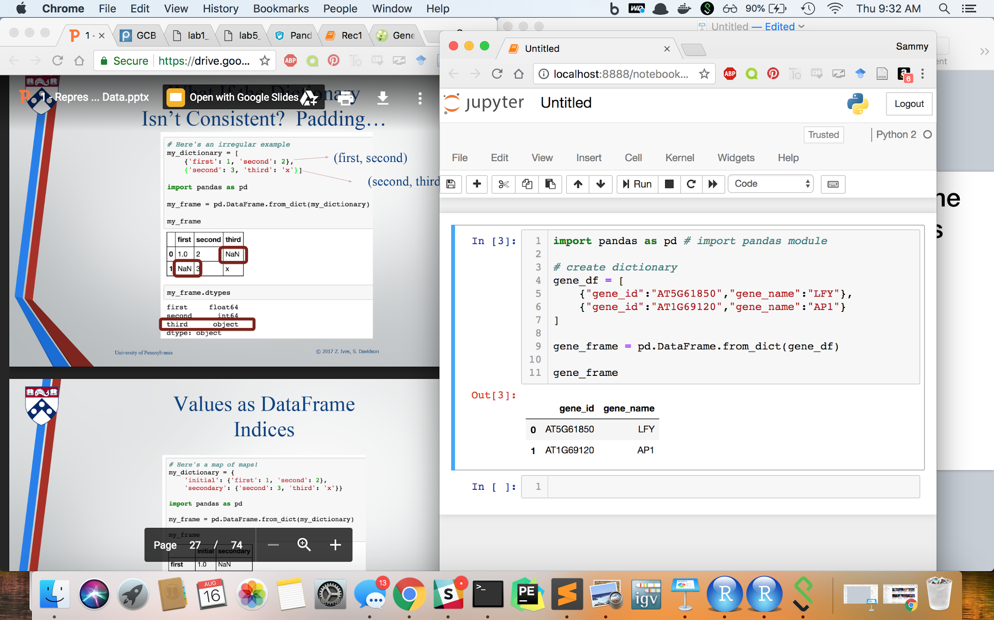
DataFrame Syntax
{
indexes
(AKA row names)

Slide 25
DataFrame Syntax
{
column names
{
indexes
(AKA row names)

Slide 26
DataFrame Syntax
{
column names
{
indexes
(AKA row names)
Values

Slide 27
2. Creating a pandas DataFrame
(WARNING:There are many different way to create a pandas DataFrame)

Slide 28
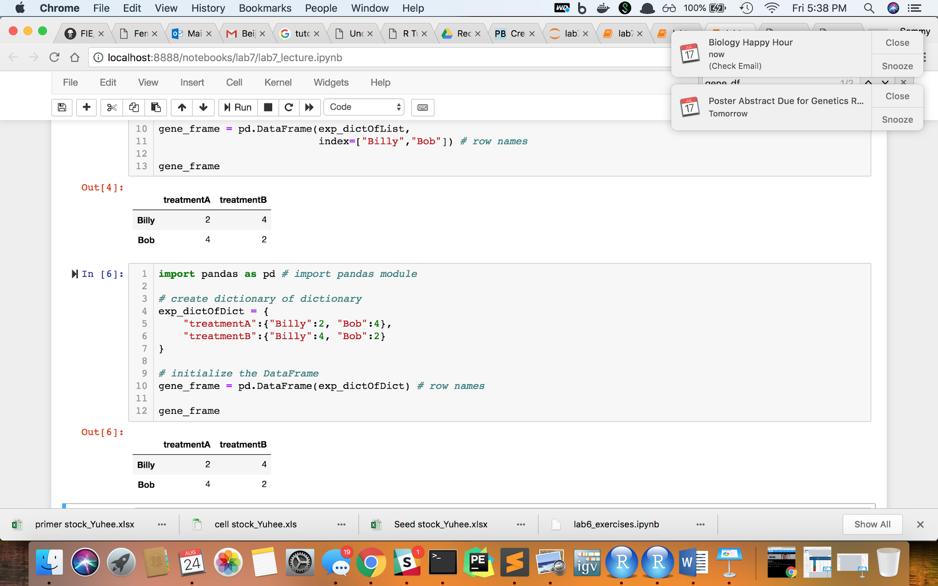
We can create a DataFrame from a Dictionary of pandas series
1 dictOfSeries = {'treatmentA':pd.Series([2,4],['Billy','Bob']),
2 'treatmentB':pd.Series([4,2],['Billy','Bob'])}
3 df = pd.DataFrame(dictOfSeries)
4 df

Slide 29
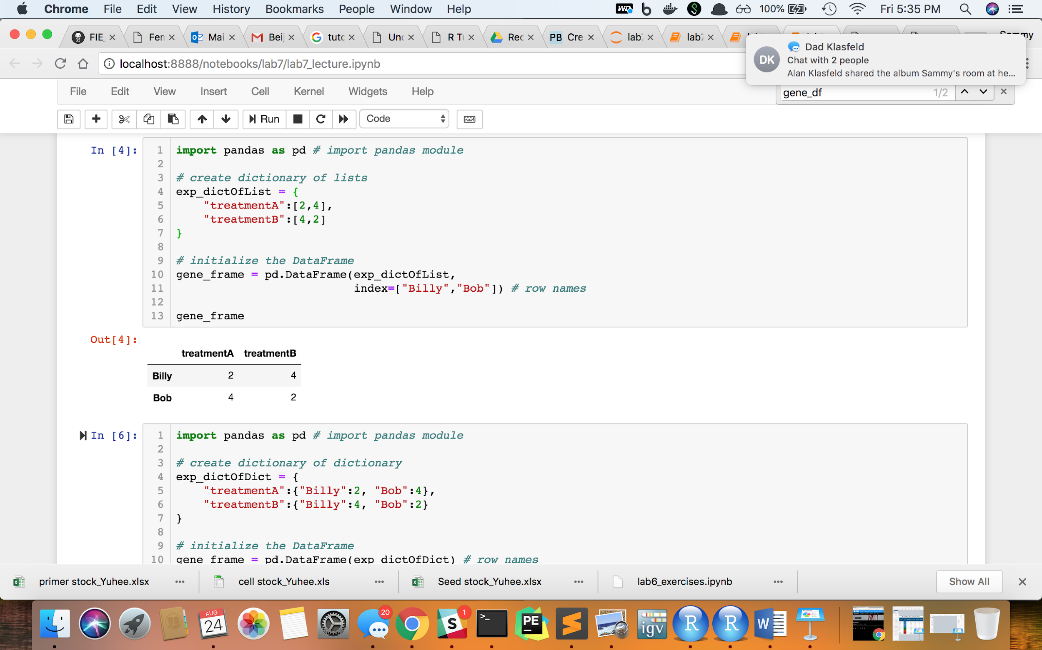
Or we can create a DataFrame from a Dictionary of Lists

Slide 30
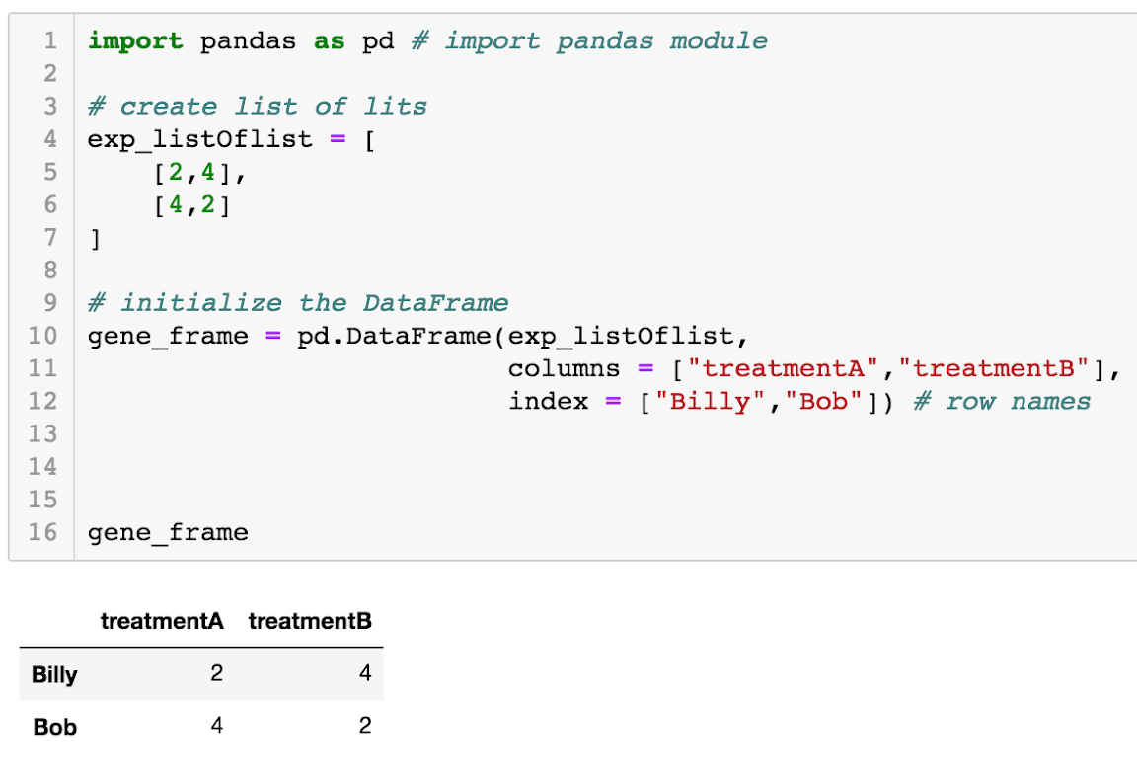
We can create a DataFrame from a List of Lists

Slide 31
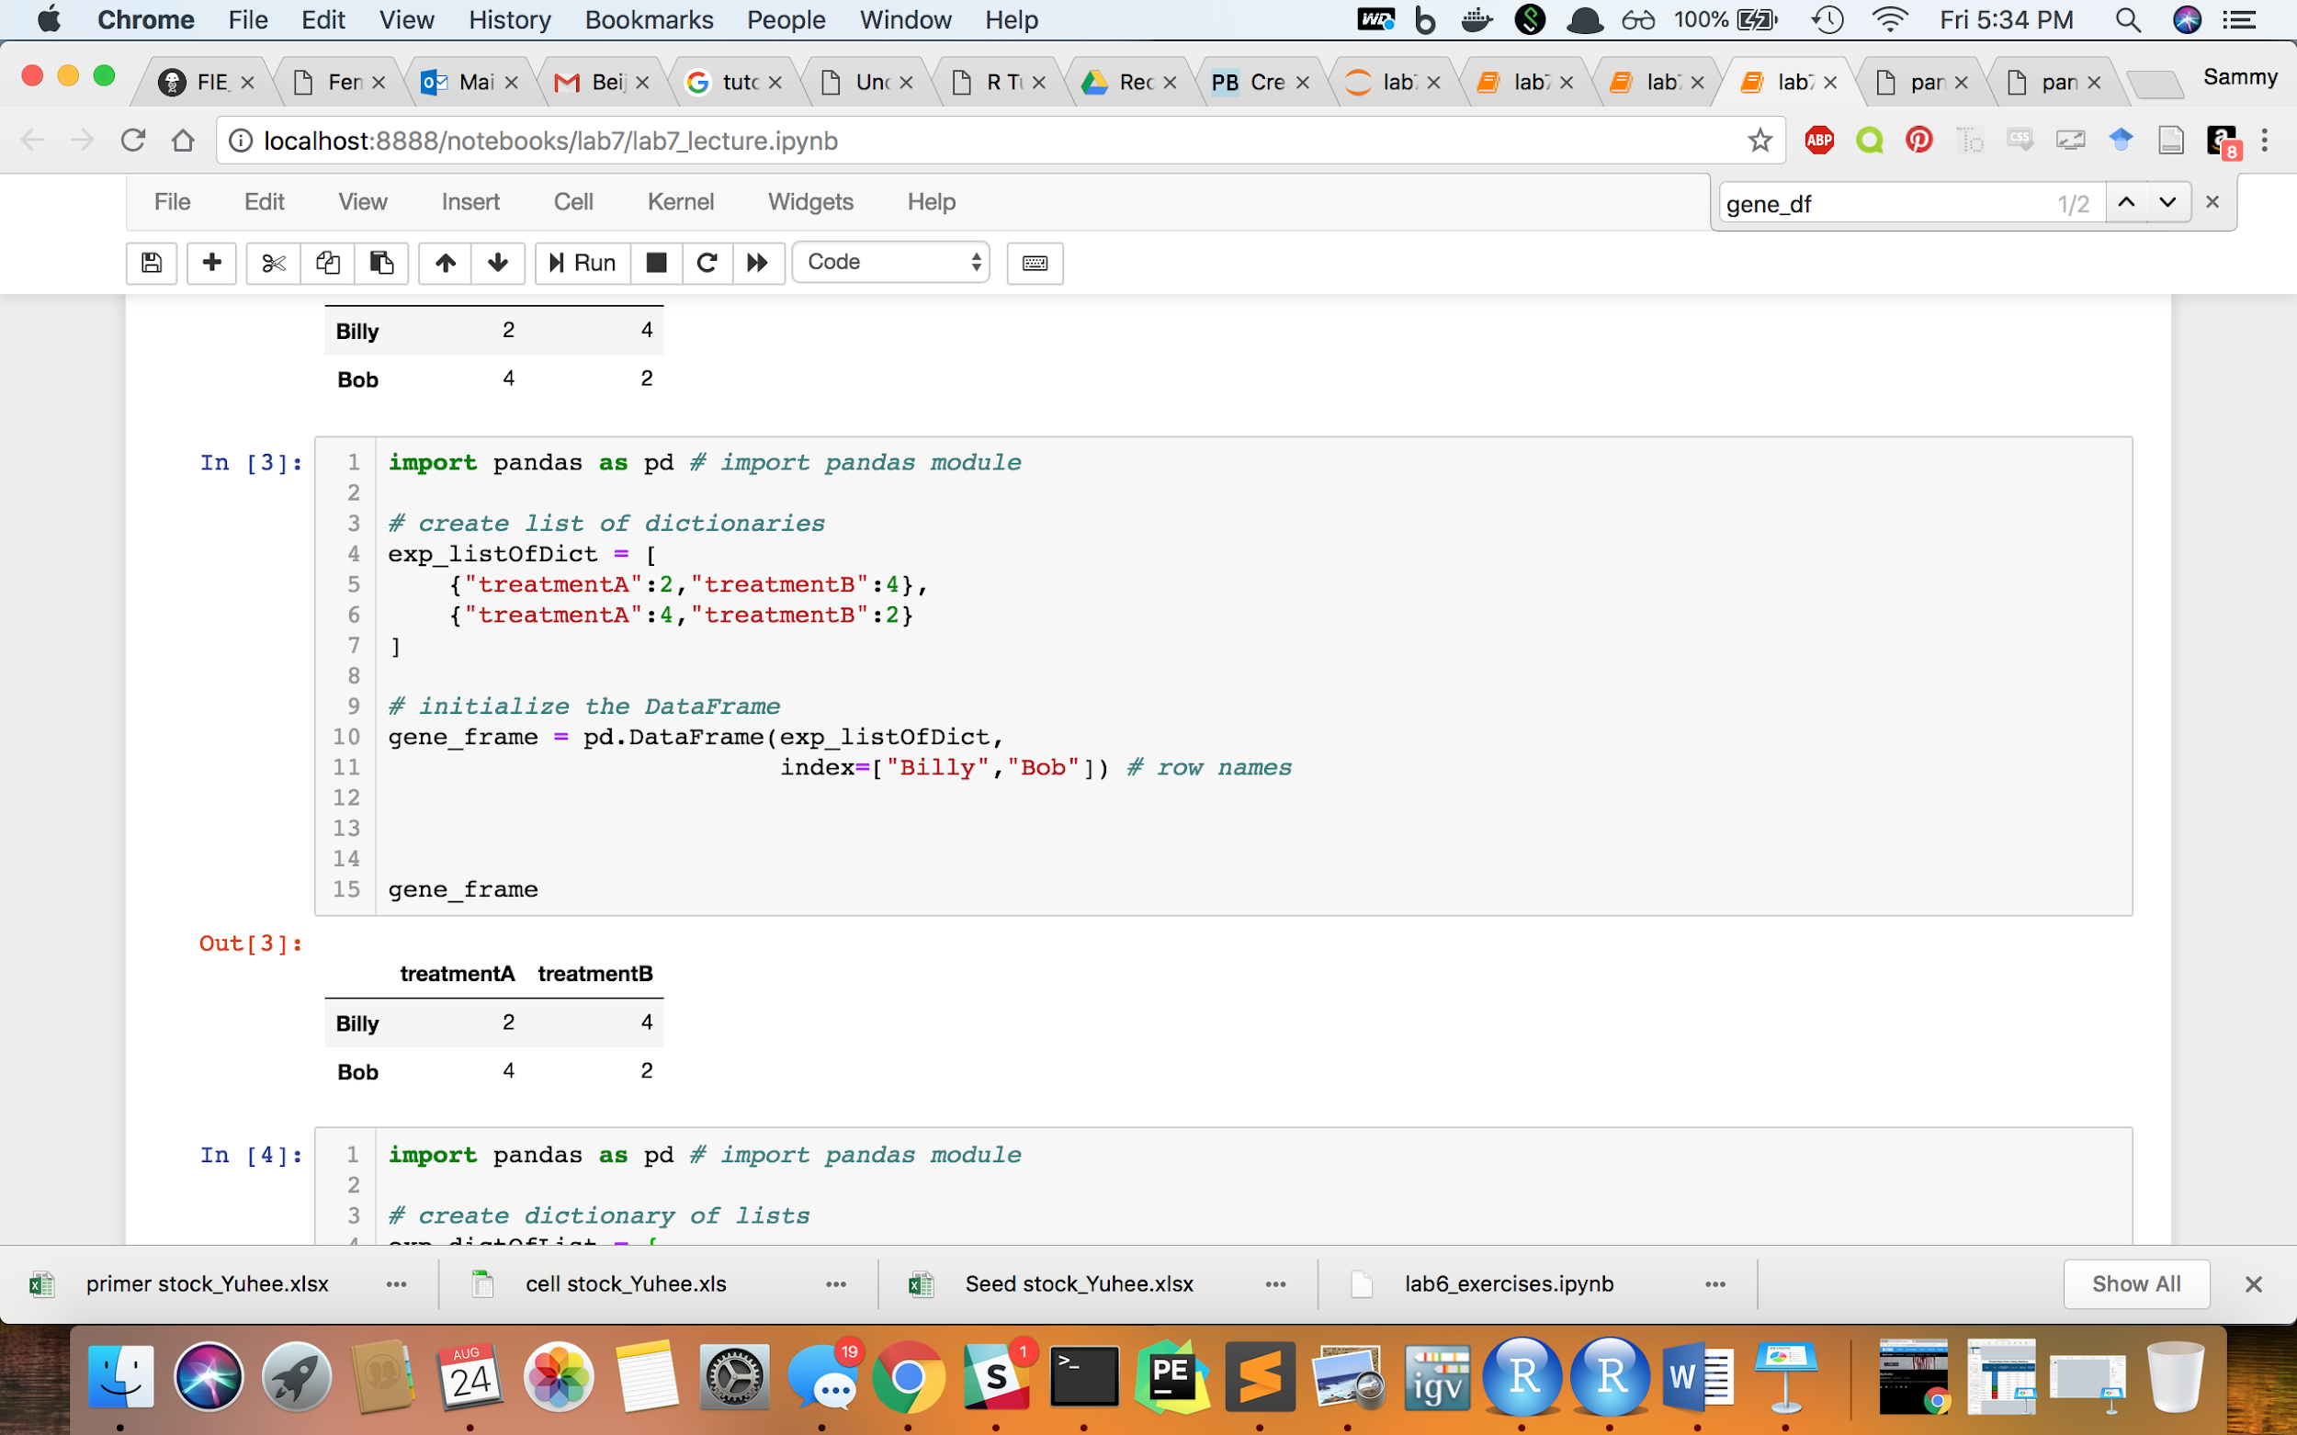
Or we can create a DataFrame from a List of Dictionaries

Slide 32
We can create a DataFrame from a Dictionary of Dictionaries

Slide 33
Importing Pandas DataFrame from a file
Import pandas and numpy module
Write list of columns
Write dictionary of columns to their data-type
Read table into python compiler

Slide 34
Importing Pandas DataFrame from a file
For example, lets say we have this bed file “example.bed” filled with genes.
Note that a bed file is tab-delimited. In this case the columns are ordered as such:
Chromosome Location
Start Location
Stop Location
Name of Feature
Score (in this case this column is uninformative)
Feature Strand
example.bed
Chr1 | 1100 | 1600 | GeneA | 255 | +
Chr2 | 15230 | 15342 | GeneB | 255 | -
Chr2 | 15352 | 15455 | GeneC | 255 | +
Chr2 | 17006 | 18110 | GeneD | 255 | +
Chr3 | 10704 | 11671 | GeneE | 255 | -

Slide 35
Step 1: Import Modules
1 # Step 1: Import modules
2 import pandas as pd # import pandas module
3 import numpy as np # import numpy module
We set pd as an alias for pandas and np as an alias for numpy now
The NumPy module provides context for mathematical operations beyond the scope of the course

Slide 36
Step 2: Make a list of the column names
1 # Step 1: Import modules
2 import pandas as pd # import pandas module
3 import numpy as np # import numpy module
1 # Step 2: List of Column Names
2 bed_columns = ["chr", # chromosome location
3 "start", # start location
4 "stop", # stop location
5 "name", # name of the feature
6 "score", # score of feature
7 "strand"] # feature strand

Slide 37
Step 3: Create a dictionary containing the data-type of each columns
(Otherwise python automatically classifies them and its NOT always right!)
1 # Step 1: Import modules
2 import pandas as pd # import pandas module
3 import numpy as np # import numpy module
1 # Step 2: List of Column Names
2 bed_columns = ["chr", # chromosome location
3 "start", # start location
4 "stop", # stop location
5 "name", # name of the feature
6 "score", # score of feature
7 "strand"] # feature strand
1 # Step 3: Dictionary of Column Types
2 bedCol_types = {"chr": str, "start": np.int64,
3 "stop": np.int64, "name": str,
4 "score": np.float64,
5 "strand": str}

Slide 38
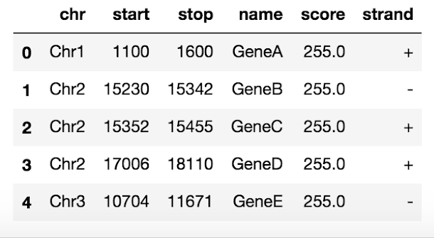
Step 4: Read the table into Pandas!
1 # Step 4: Read the table into the python compiler
2 bed_df = pd.read_csv("example.bed",
3 sep = "\t", # file is tab-delimited
4 header = None, # the column names are
5 # not in file
6 names = bedCols, # sets column names
7 dtype = bedCol_types) # sets column types
8 bed_df
For more parameters see : http://pandas.pydata.org/pandas-docs/stable/.

Slide 39
Pandas can even work with Excel!
See link: https://pandas.pydata.org/pandas-docs/stable/reference/api/pandas.read_excel.html

Slide 40
Basic DataFrame Functions
bed_df.head(n=X) : gets the first X rows (default: n=5 if not stated)
bed_df.tail(n=X) : gets the last X rows (default: n=5 if not stated)
bed_df.columns : gets column names
bed_df.index : gets row names
bed_df.dtypes : gets datatypes of each column
bed_df.shape : gets height and width of the DataFrame in a list format
len(bed_df) : gets the height of the DataFrame
bed_df.describe(): generates descriptive statistics

Slide 41
3. Selecting an index or column from a pandas dataframe

Slide 42
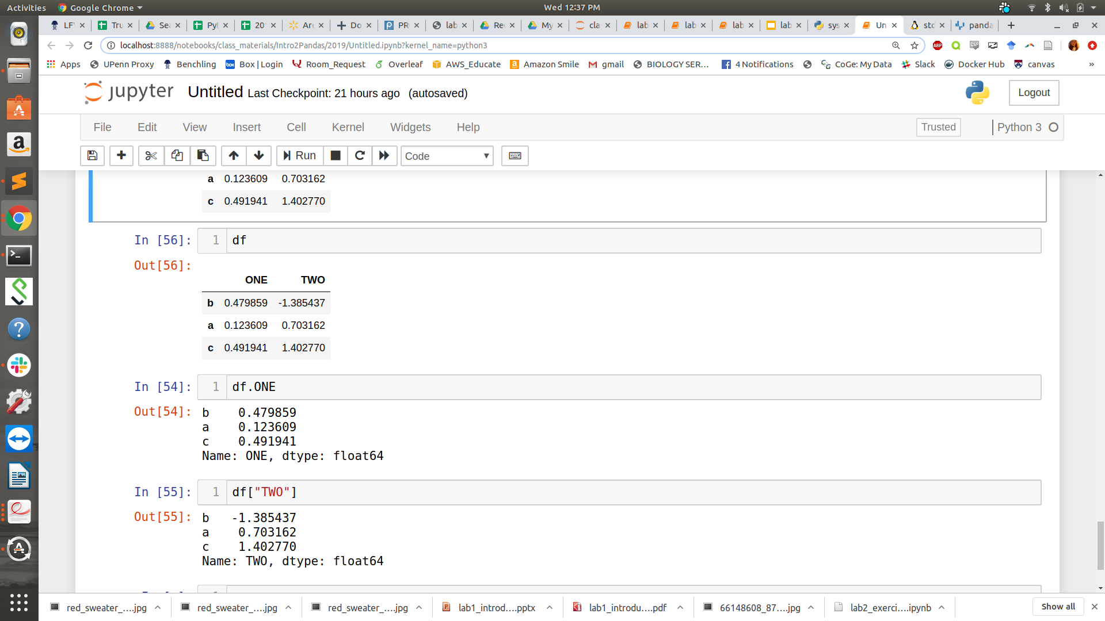
Access to columns
df =
Access by attribute - can be converted to list via (df.ONE) function
Access by dictionary like notation - can be converted to list via list(df[‘ONE’]) function

Slide 43
Selecting an Index or Column From a DataFrame using .iloc & .loc
.iloc[<row_idx>, <col_idx>] - command to get values in DataFrame based on row and column locations
.loc[<row_names>, <col_names>] - command to get values in DataFrame based on row values and column values

Slide 44
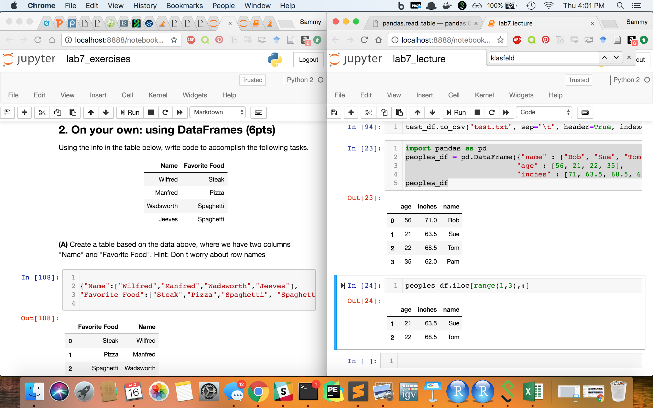
Which rows will print after the following command (from which row indexes)?
1 import pandas as pd
2 peoples_df = pd.DataFrame(
3 {"name" : ["Bob", "Sue", "Tom", “Pam”],
4 "age" : [56, 21, 22, 35],
5 "inches" : [71, 63.5, 68.5, 62]})
6 peoples_df
1 peoples_df.iloc[range(1,3),:]

Slide 45
Which rows will print after the following command (from which row indexes)?
1 import pandas as pd
2 peoples_df = pd.DataFrame(
3 {"name" : ["Bob", "Sue", "Tom", “Pam”],
4 "age" : [56, 21, 22, 35],
5 "inches" : [71, 63.5, 68.5, 62]})
6 peoples_df
1 peoples_df.iloc[range(1,3),:]
variable name for DataFrame

Slide 46
Which rows will print after the following command (from which row indexes)?
1 import pandas as pd
2 peoples_df = pd.DataFrame(
3 {"name" : ["Bob", "Sue", "Tom", “Pam”],
4 "age" : [56, 21, 22, 35],
5 "inches" : [71, 63.5, 68.5, 62]})
6 peoples_df
1 peoples_df.iloc[range(1,3),:]
variable name for DataFrame
get values in DataFrame based on row and column locations

Slide 47
Which rows will print after the following command (from which row indexes)?
1 import pandas as pd
2 peoples_df = pd.DataFrame(
3 {"name" : ["Bob", "Sue", "Tom", “Pam”],
4 "age" : [56, 21, 22, 35],
5 "inches" : [71, 63.5, 68.5, 62]})
6 peoples_df
This gives a range of numbers from 1-2 for row locations
1 peoples_df.iloc[range(1,3),:]
variable name for DataFrame
get values in DataFrame based on row and column locations

Slide 48
Which rows will print after the following command (from which row indexes)?
1 import pandas as pd
2 peoples_df = pd.DataFrame(
3 {"name" : ["Bob", "Sue", "Tom", “Pam”],
4 "age" : [56, 21, 22, 35],
5 "inches" : [71, 63.5, 68.5, 62]})
6 peoples_df
This gives a range of numbers from 1-2 for row locations
1 peoples_df.iloc[range(1,3),:]
This colon symbol represents all of the columns
variable name for DataFrame
get values in DataFrame based on row and column locations

Slide 49

Which rows will print after the following command (from which row indexes)?
1 import pandas as pd
2 peoples_df = pd.DataFrame(
3 {"name" : ["Bob", "Sue", "Tom", "Pam"],
4 "age" : [56, 21, 22, 35],
5 "inches" : [71, 63.5, 68.5, 62]})
6 peoples_df
1 peoples_df.iloc[range(1,3),:]
ANSWER: This prints rows with indexes 1 & 2
since they are the second and third row

Slide 50
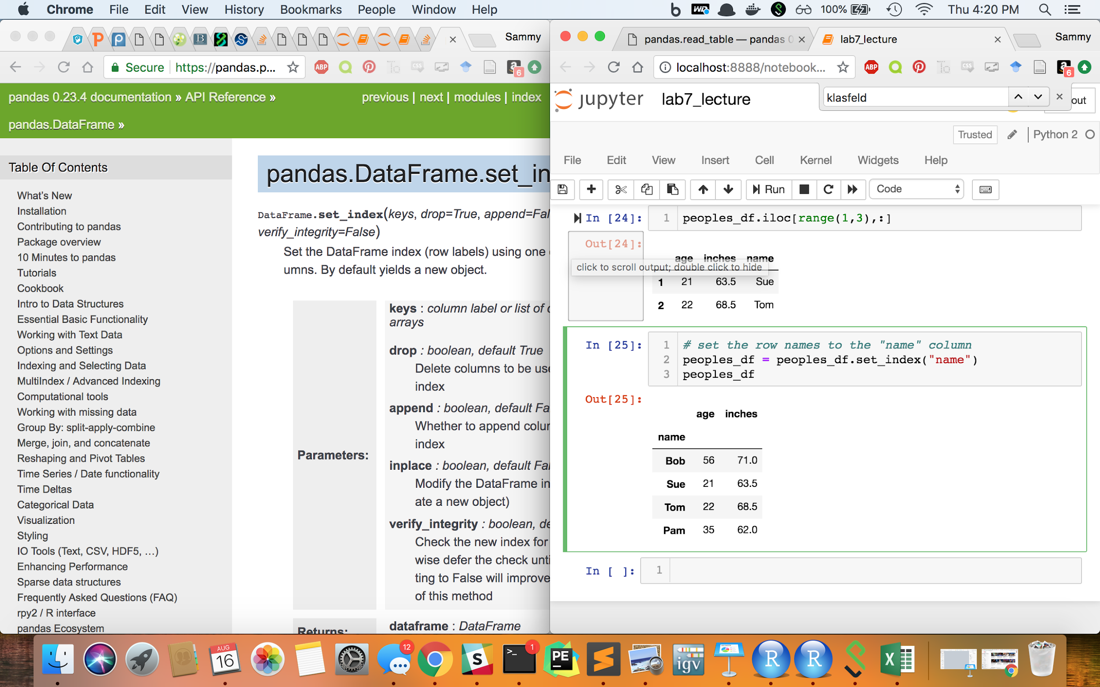
Which rows will print after the following command?
1 peoples_df.loc[range(1,3),:]

Slide 51
Which rows will print after the following command?
1 peoples_df.loc[range(1,3),:]
ANSWER: This also prints rows with indexes 1 & 2
since the value of these row indexes are 1 & 2 respectively since we do NOT have row names

Slide 52
Setting Row Names with .set_index()

Slide 53
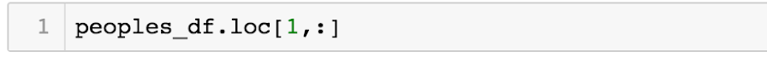
Which rows will print after the following command?

Slide 54
Which rows will print after the following command?
ANSWER: This prints an ERROR since there is no row name “1”

Slide 55
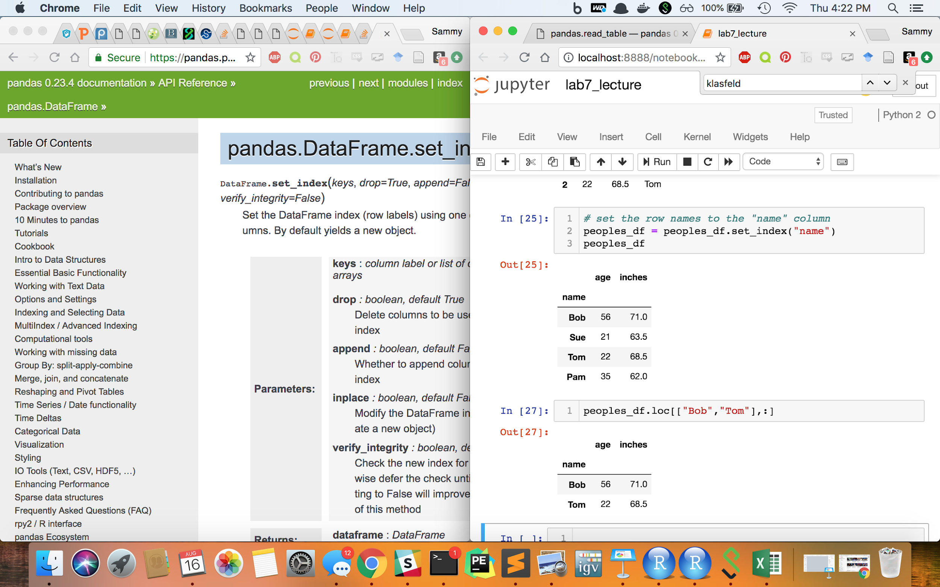
Which rows will print after the following command?

Slide 56
Which rows will print after the following command?
ANSWER: This prints the rows with row names “Bob” and “Tom”

Slide 57
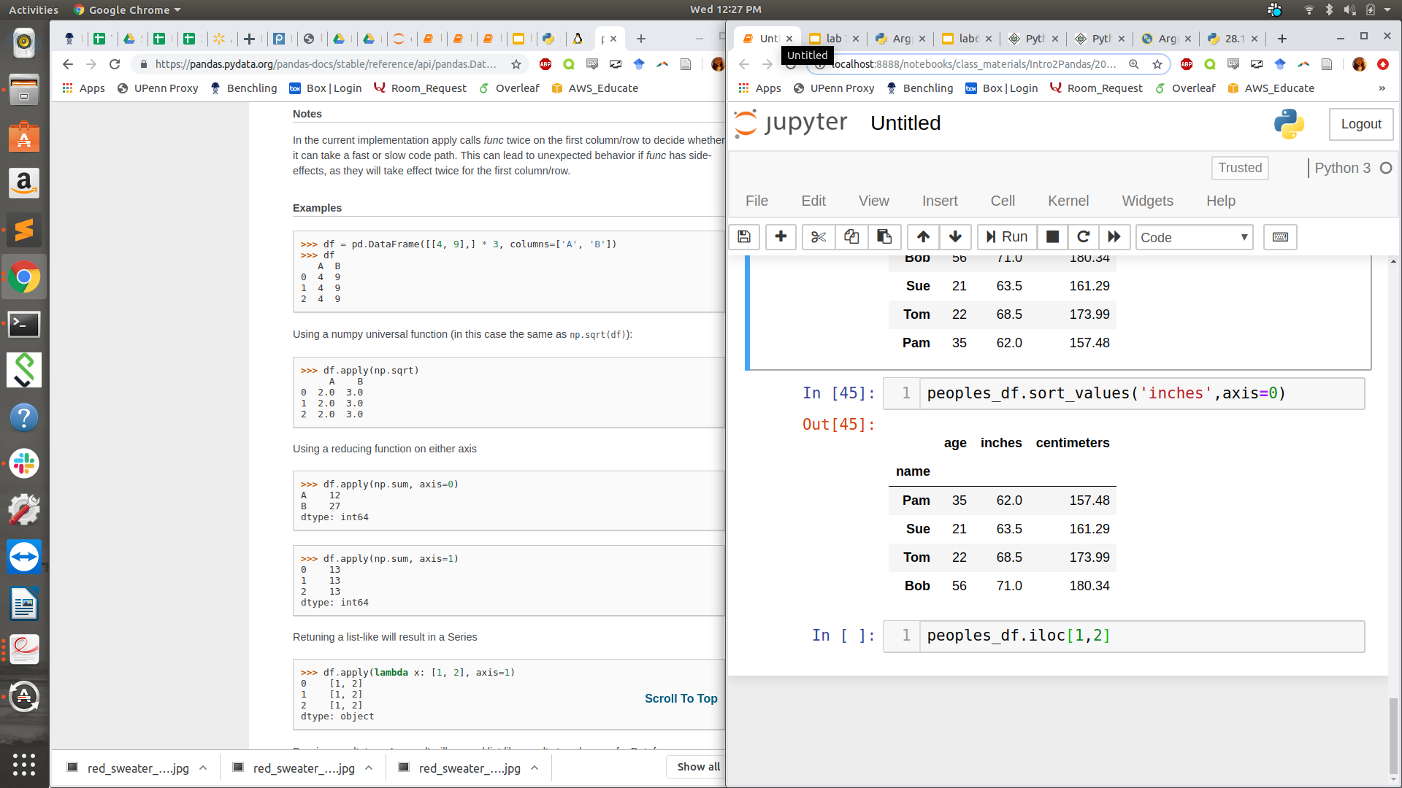
What value would this print?

Slide 58
What value would this print?
ANSWER: 63.5

Slide 59
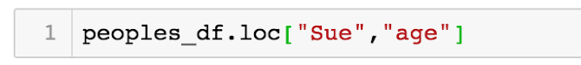
What value would this print?

Slide 60
What value would this print?
ANSWER: 21

Slide 61
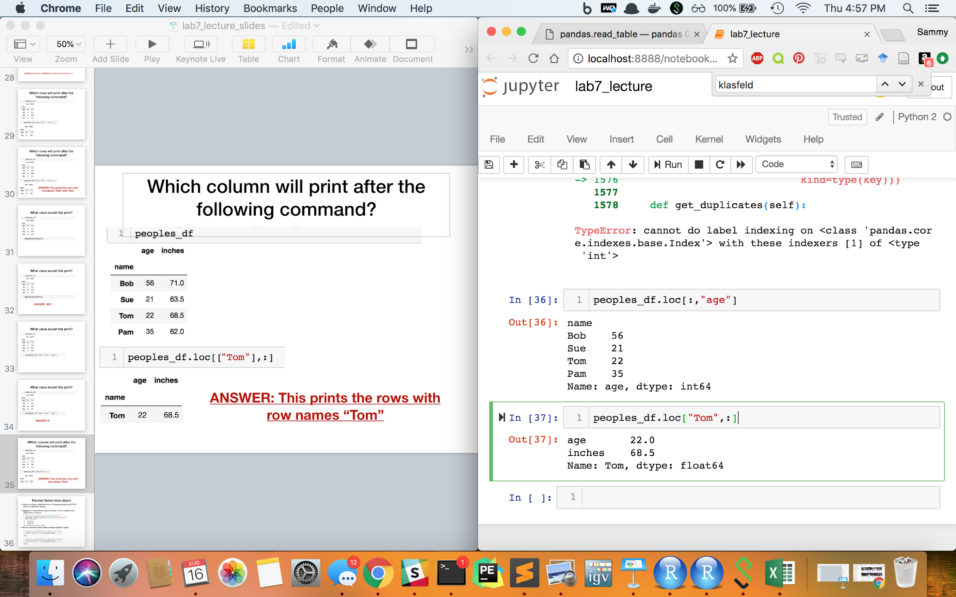
Which column will print after the following command?

Slide 62
Which column will print after the following command?
ANSWER: The “age” column
But why is the output formatted differently?

Slide 63
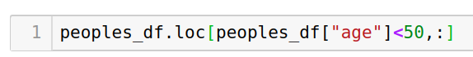
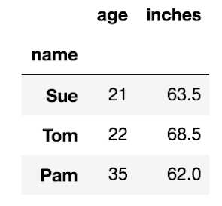
DataFrame Conditionals
Occasionally you may want to subset a DataFrame based on specific columns. For example, we may want to subset the “peoples_df” to people under the age of 50.
Using the .loc command we can use conditionals on rows (the first parameter) and/or columns (the second parameter)

Slide 64
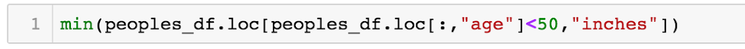
What value would this print?

Slide 65
What value would this print?
ANSWER: 62.0

Slide 66
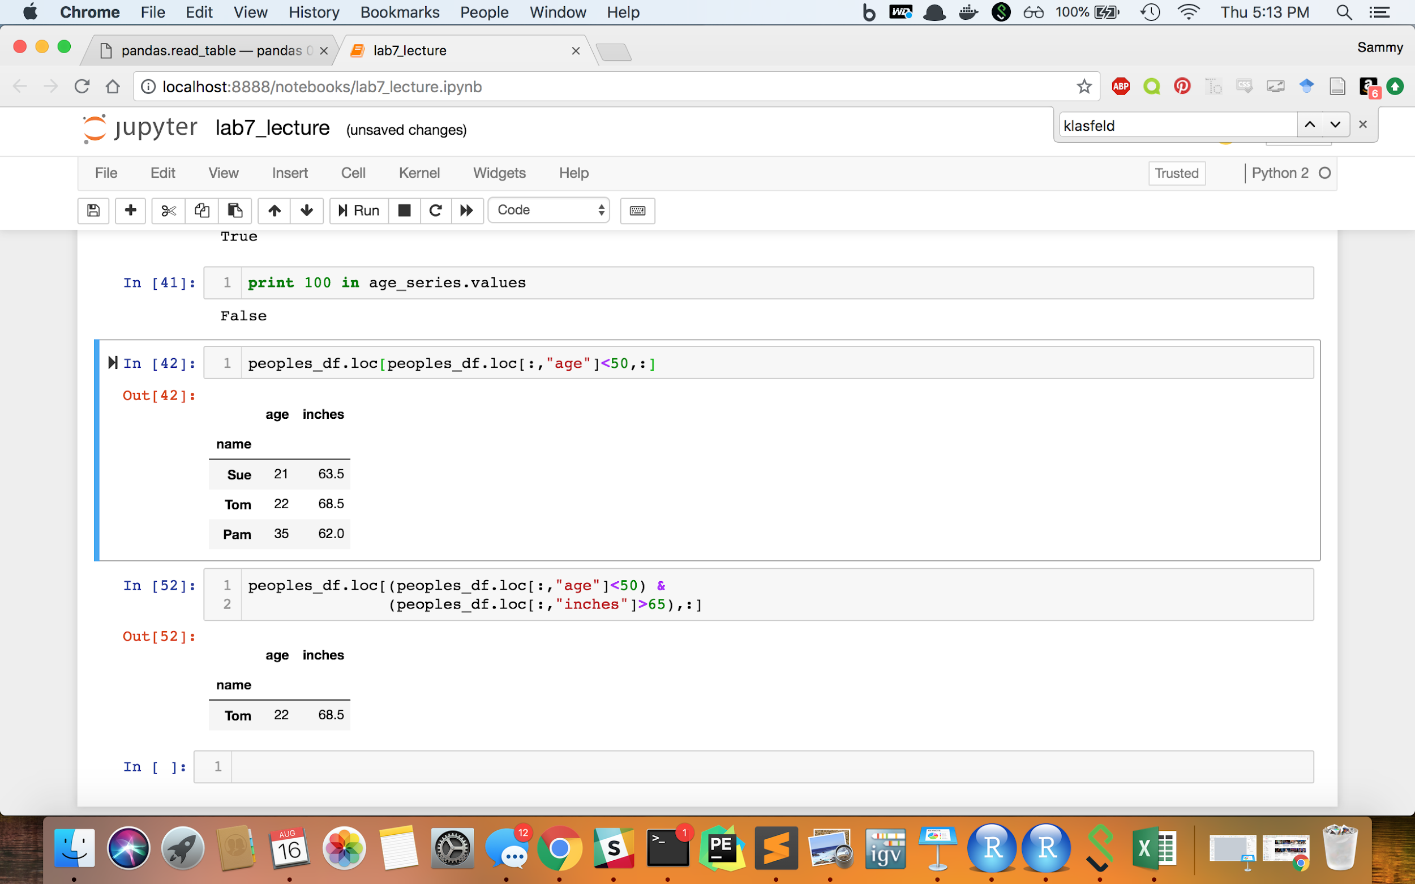
What row(s) would this print?
Note: for multiple conditions inside
.loc or .iloc we only use a single ampersand

Slide 67
What row(s) would this print?
ANSWER:

Slide 68
4. Writing a dataframe to a file

Slide 69
Exporting a DataFrame to a File
Similar to importing a text file to a pandas DataFrame, there are also several parameters for exporting a pandas DataFrame.
The syntax for exporting a DataFrame is :
dataFrame.to_csv(path_to_outputFile, arguments)
For example, to export a tab-delimited file from DataFrame `test_df` with a header and no row-names to the file “test.txt” we use the command:
test_df.to_csv(“test.txt”, sep=“\t”, header=True, index=False)

Slide 70
5. Updating DataFrames

Slide 71
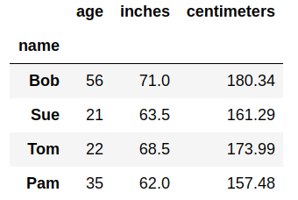
Creating New Columns
You should always add columns using the .loc and .iloc commands to avoid SettingWithCopyWarnings.
For example, we can add a row for height in “centimeters” in addition to inches:
peoples_df.loc[:,"centimeters"] = \
Peoples_df.loc[:,"inches"] * 2.54
peoples_df
Notes:
Note you should always use .loc and .iloc to create new columns to avoid a SettingWithCopyWarning

Slide 72
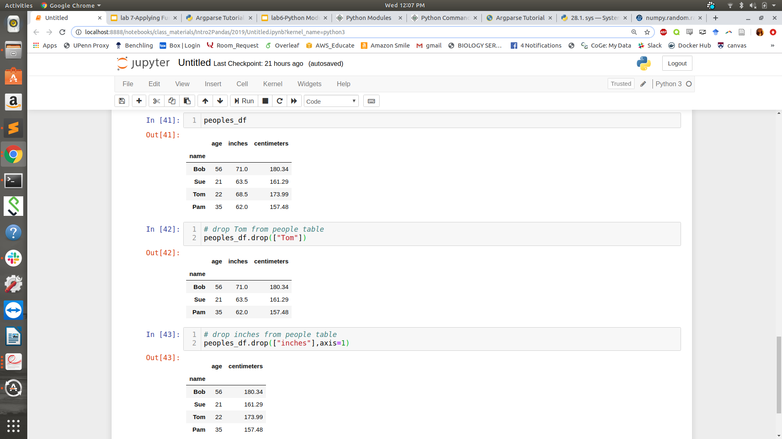
Dropping Rows/Columns
Drop rows or columns using the .drop() function
peoples_df
# drop row from peoples table
peoples_df.drop(["Tom"])

Slide 73
Dropping Rows/Columns
Drop rows or columns using the .drop() function
peoples_df
# drop column from peoples table
peoples_df.drop(["inches"],axis=1)
# drop row from peoples table
peoples_df.drop(["Tom"])

Slide 74
Dropping Rows/Columns
Drop rows or columns using the .drop() function
peoples_df
Note: This function DOES NOT RUN IN PLACE. This means that we must set our dataframe to our command to update it
# drop column from peoples table
peoples_df.drop(["inches"],axis=1)
# drop row from peoples table
peoples_df.drop(["Tom"])

Slide 75
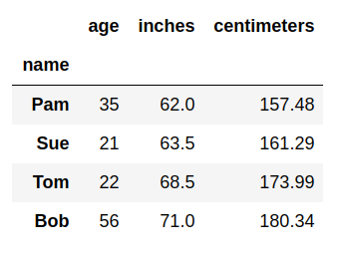
Sorting DataFrames
Sort rows using the .sort_values() function
# original table
peoples_df
# sort row by column “inches”
peoples_df.sort_values("inches",ascending=True)
This function also DOES NOT RUN IN PLACE. This means that we must set our dataframe to our command update it.
By default, .sort_values() sorts rows, but if user sets “axis=1” inside the function, it will sort columns instead.

Slide 76
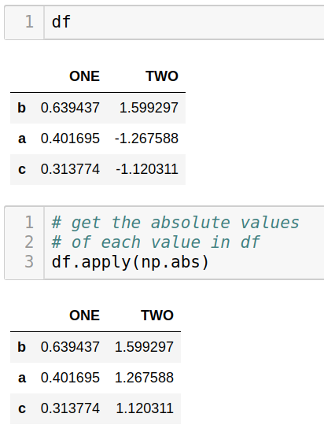
Applying functions to DataFrames

Slide 77
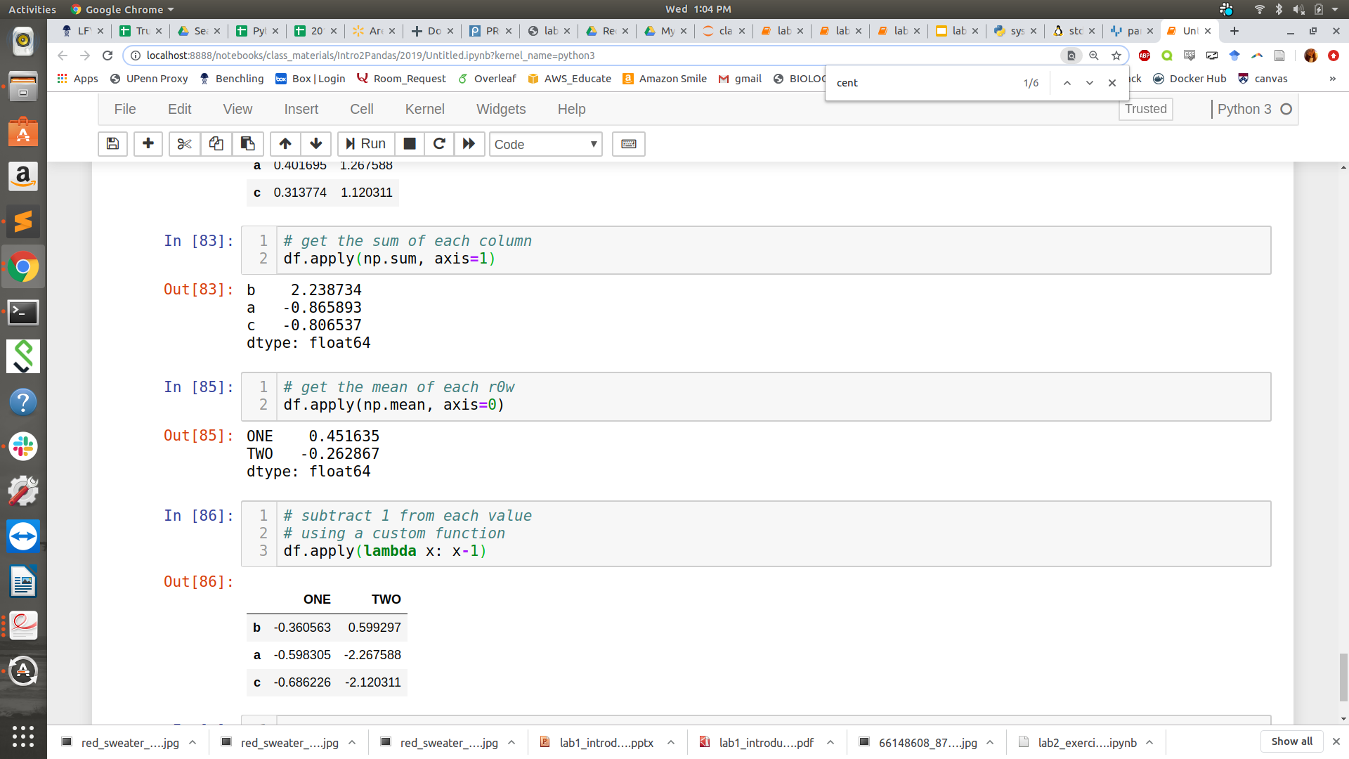
Applying functions to DataFrames

Slide 78
Applying functions to DataFrames

Slide 79
Applying functions to DataFrames

Slide 80
6. Combining DataFrames together

Slide 81
Combining DataFrames
Up to this point, we have been working with a single table at a time, but most of the time we work with many tables that can be related to each other in some way.

Slide 82
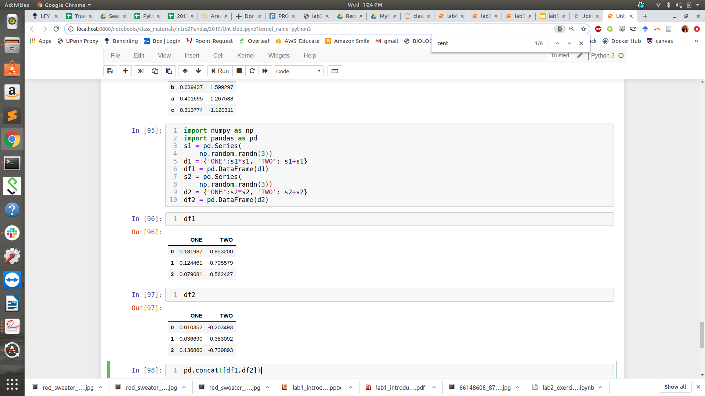
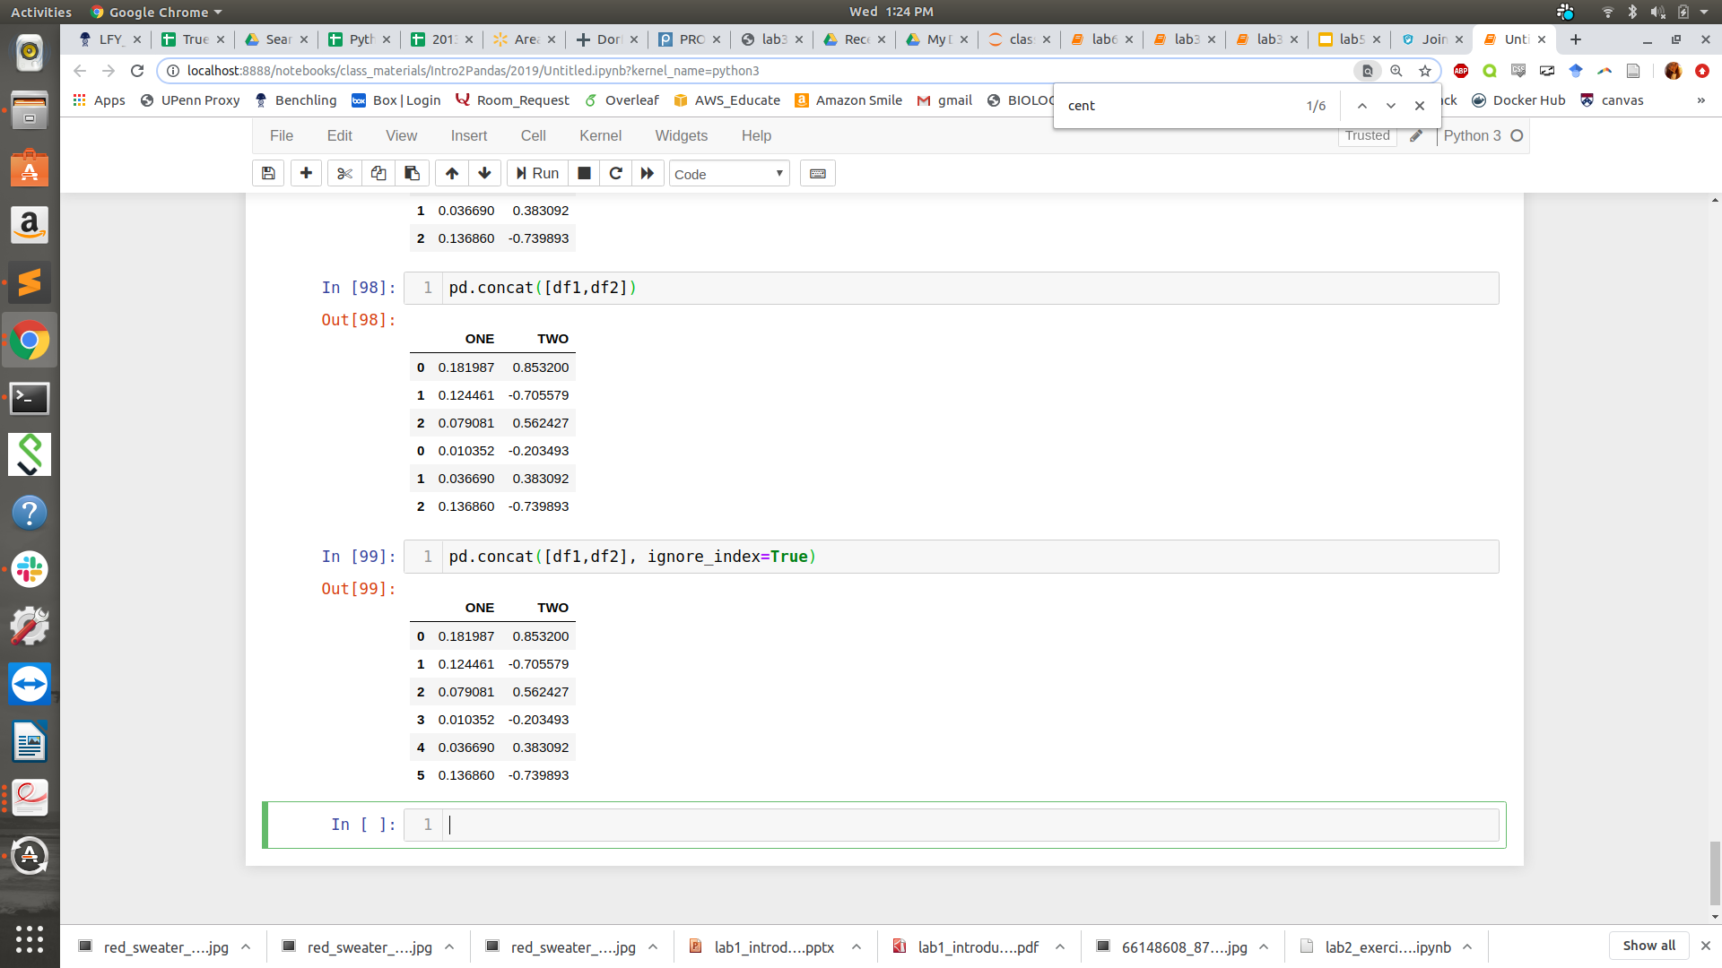
Concatenating DataFrames
It is easy to merge multiple dataframes that have the same columns together using the pandas concat() function
We use ignore_index to reset the indices so that there are none that are redundant

Slide 83
Merging DataFrames
Concatenation is useful if your data frames have the same types of information (the same columns) but about different identities (different rows)
Sometimes you have tables that contain data about the same set of items (found in rows) but contain different information about those items (some different columns)
Peak ID | Gene ID | Distance From Peak to Gene
1 | AT5G61850 | 50
2 | AT5G61850 | 0
3 | AT1G17180 | 0
4 | AT2G11180 | 210
Gene ID | Function
AT1G17180 | Ribosomal
AT1G17190 | Respiratory
AT1G17200 | Respiratory
AT1G17201 | Stress Response
Notes:
We have one table that contains chip peaks and their distance to genes and then another table that contains gene information. We want to merge them so that we know how close peaks are to specific types of genes.

Slide 84
Database Terminology
Primary key - column(s) in a table that is a unique identifier for each row
Foreign key - column(s) in a table that specify a link to a primary key in another table
These keys are where we combine two tables
Foreign Key
Primary Key
Peak ID | Gene ID | Distance From Peak to Gene
1 | AT5G61850 | 50
2 | AT5G61850 | 0
3 | AT1G17180 | 0
4 | AT2G11180 | 210
Gene ID | Function
AT1G17180 | Ribosomal
AT1G17190 | Respiratory
AT1G17200 | Respiratory
AT1G17201 | Stress Response

Slide 85
Pandas merge function
>>>df1 = pd.DataFrame({'lkey': ['foo', 'bar', 'baz', 'faa'],
'value': [1, 2, 3, 5]})
>> df1
lkey value
0 foo 1
1 bar 2
2 baz 3
3 faa 5
>>>df2 = pd.DataFrame({'rkey': ['foo', 'bar', 'baz', 'faa'],
'value': [1, 2, 3, 5]})
>> df2
rkey value
0 foo 6
1 bar 7
2 baz 8
3 faa 9
df1.merge(df2, left_on='lkey', right_on='rkey')
Left
data
frame
Right
data
frame
Left primary/
foreign key
Right primary/
foreign key

Slide 86
Pandas merge function
>>>df1 = pd.DataFrame({'lkey': ['foo', 'bar', 'baz', 'faa'],
'value': [1, 2, 3, 5]})
>> df1
lkey value
0 foo 1
1 bar 2
2 baz 3
3 faa 5
>>>df2 = pd.DataFrame({'rkey': ['foo', 'bar', 'baz', 'faa'],
'value': [1, 2, 3, 5]})
>> df2
rkey value
0 foo 6
1 bar 7
2 baz 8
3 faa 9
df1.merge(df2, left_on='lkey', right_on='rkey')
lkey value_x rkey value_y
0 foo 1 foo 5
1 bar 2 bar 6
2 baz 3 baz 7
3 faa 5 faa 8

Slide 87
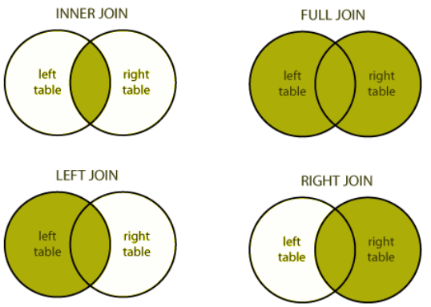
Different Ways to join a DataFrame
Not all data frames have the exact same foreign keys that match the primary keys. Some keys should match but each data frame may have keys that are not found in the other.
There are four primary ways to join two tables together
*
* INNER JOIN is the default for pandas merge
Notes:
We have one table that contains chip peaks and their distance to genes and then another table that contains gene information. We want to merge them so that we know how close peaks are to specific types of genes.

Slide 88
Different Ways to join a DataFrame
IDs in df1: a,b,c IDs in df2: a,b,d ----> IDs in merged: a,b
IDs in df1: a,b,c IDs in df2: a,b,d ----> IDs in merged: a,b,c
IDs in df1: a,b,c IDs in df2: a,b,d ----> IDs in merged: a,b,d
IDs in df1: a,b,c IDs in df2: a,b,d ----> IDs in merged: a,b,c,d

Slide 89
Different Ways to join a DataFrame
IDs in df1: a,b,c IDs in df2: a,b,d ----> IDs in merged: a,b
IDs in df1: a,b,c IDs in df2: a,b,d ----> IDs in merged: a,b,c
IDs in df1: a,b,c IDs in df2: a,b,d ----> IDs in merged: a,b,d
IDs in df1: a,b,c IDs in df2: a,b,d ----> IDs in merged: a,b,c,d
inner join

Slide 90
Different Ways to join a DataFrame
IDs in df1: a,b,c IDs in df2: a,b,d ----> IDs in merged: a,b
IDs in df1: a,b,c IDs in df2: a,b,d ----> IDs in merged: a,b,c
IDs in df1: a,b,c IDs in df2: a,b,d ----> IDs in merged: a,b,d
IDs in df1: a,b,c IDs in df2: a,b,d ----> IDs in merged: a,b,c,d
inner join
left join

Slide 91
Different Ways to join a DataFrame
IDs in df1: a,b,c IDs in df2: a,b,d ----> IDs in merged: a,b
IDs in df1: a,b,c IDs in df2: a,b,d ----> IDs in merged: a,b,c
IDs in df1: a,b,c IDs in df2: a,b,d ----> IDs in merged: a,b,d
IDs in df1: a,b,c IDs in df2: a,b,d ----> IDs in merged: a,b,c,d
inner join
left join
right join

Slide 92
Different Ways to join a DataFrame
IDs in df1: a,b,c IDs in df2: a,b,d ----> IDs in merged: a,b
IDs in df1: a,b,c IDs in df2: a,b,d ----> IDs in merged: a,b,c
IDs in df1: a,b,c IDs in df2: a,b,d ----> IDs in merged: a,b,d
IDs in df1: a,b,c IDs in df2: a,b,d ----> IDs in merged: a,b,c,d
inner join
left join
right join
outer join

Slide 93

Game time:
NAME THAT JOIN

Slide 94
WHAT JOIN DID WE USE?
student_df
course_df
 | student_id | first_name | last_name
0 | 111 | Alex | Anderson
1 | 222 | Amy | Brown
2 | 333 | Alan | Cooper
 | sid | course_name
0 | 111 | Calculus
1 | 111 | Chemistry
2 | 222 | Biology
3 | 444 | English
AFTER MERGE
 | student_id | first_name | last_name | sid | course_name
0 | 111 | Alex | Anderson | 111 | Calculus
1 | 111 | Alex | Anderson | 111 | Chemistry
2 | 222 | Amy | Brown | 222 | Biology
3 | 333 | Alan | Cooper | NaN | Nan
4 | NaN | NaN | NaN | 444 | English

Slide 95
WHAT JOIN DID WE USE?
student_df
course_df
 | student_id | first_name | last_name
0 | 111 | Alex | Anderson
1 | 222 | Amy | Brown
2 | 333 | Alan | Cooper
 | sid | course_name
0 | 111 | Calculus
1 | 111 | Chemistry
2 | 222 | Biology
3 | 444 | English
AFTER MERGE
 | student_id | first_name | last_name | sid | course_name
0 | 111 | Alex | Anderson | 111 | Calculus
1 | 111 | Alex | Anderson | 111 | Chemistry
2 | 222 | Amy | Brown | 222 | Biology
3 | 333 | Alan | Cooper | NaN | Nan
4 | NaN | NaN | NaN | 444 | English
OUTER JOIN!
student_df.merge(
course_df,
left_on='student_id',
right_on='sid',
how='outer')

Slide 96
WHAT JOIN DID WE USE?
student_df
course_df
 | student_id | first_name | last_name
0 | 111 | Alex | Anderson
1 | 222 | Amy | Brown
2 | 333 | Alan | Cooper
 | sid | course_name
0 | 111 | Calculus
1 | 111 | Chemistry
2 | 222 | Biology
3 | 444 | English
AFTER MERGE
 | student_id | first_name | last_name | sid | course_name
0 | 111 | Alex | Anderson | 111 | Calculus
1 | 111 | Alex | Anderson | 111 | Chemistry
2 | 222 | Amy | Brown | 222 | Biology
4 | NaN | NaN | NaN | 444 | English

Slide 97
WHAT JOIN DID WE USE?
student_df
course_df
 | student_id | first_name | last_name
0 | 111 | Alex | Anderson
1 | 222 | Amy | Brown
2 | 333 | Alan | Cooper
 | sid | course_name
0 | 111 | Calculus
1 | 111 | Chemistry
2 | 222 | Biology
3 | 444 | English
AFTER MERGE
 | student_id | first_name | last_name | sid | course_name
0 | 111 | Alex | Anderson | 111 | Calculus
1 | 111 | Alex | Anderson | 111 | Chemistry
2 | 222 | Amy | Brown | 222 | Biology
4 | NaN | NaN | NaN | 444 | English
RIGHT JOIN!
student_df.merge(
course_df,
left_on='student_id',
right_on='sid',
how='outer')

Slide 98
WHAT JOIN DID WE USE?
student_df
course_df
 | student_id | first_name | last_name
0 | 111 | Alex | Anderson
1 | 222 | Amy | Brown
2 | 333 | Alan | Cooper
 | sid | course_name
0 | 111 | Calculus
1 | 111 | Chemistry
2 | 222 | Biology
3 | 444 | English
AFTER MERGE
 | student_id | first_name | last_name | sid | course_name
0 | 111 | Alex | Anderson | 111 | Calculus
1 | 111 | Alex | Anderson | 111 | Chemistry
2 | 222 | Amy | Brown | 222 | Biology

Slide 99
WHAT JOIN DID WE USE?
student_df
course_df
 | student_id | first_name | last_name
0 | 111 | Alex | Anderson
1 | 222 | Amy | Brown
2 | 333 | Alan | Cooper
 | sid | course_name
0 | 111 | Calculus
1 | 111 | Chemistry
2 | 222 | Biology
3 | 444 | English
AFTER MERGE
 | student_id | first_name | last_name | sid | course_name
0 | 111 | Alex | Anderson | 111 | Calculus
1 | 111 | Alex | Anderson | 111 | Chemistry
2 | 222 | Amy | Brown | 222 | Biology
INNER JOIN!
student_df.merge(
course_df,
left_on='student_id',
right_on='sid')

Slide 100
WHAT JOIN DID WE USE?
student_df
course_df
 | student_id | first_name | last_name
0 | 111 | Alex | Anderson
1 | 222 | Amy | Brown
2 | 333 | Alan | Cooper
 | sid | course_name
0 | 111 | Calculus
1 | 111 | Chemistry
2 | 222 | Biology
3 | 444 | English
AFTER MERGE
 | student_id | first_name | last_name | sid | course_name
0 | 111 | Alex | Anderson | 111 | Calculus
1 | 111 | Alex | Anderson | 111 | Chemistry
2 | 222 | Amy | Brown | 222 | Biology
3 | 333 | Alan | Cooper | NaN | Nan

Slide 101
WHAT JOIN DID WE USE?
student_df
course_df
 | student_id | first_name | last_name
0 | 111 | Alex | Anderson
1 | 222 | Amy | Brown
2 | 333 | Alan | Cooper
 | sid | course_name
0 | 111 | Calculus
1 | 111 | Chemistry
2 | 222 | Biology
3 | 444 | English
AFTER MERGE
 | student_id | first_name | last_name | sid | course_name
0 | 111 | Alex | Anderson | 111 | Calculus
1 | 111 | Alex | Anderson | 111 | Chemistry
2 | 222 | Amy | Brown | 222 | Biology
3 | 333 | Alan | Cooper | NaN | Nan
LEFT JOIN!
student_df.merge(
course_df,
left_on='student_id',
right_on='sid',
how='left')

Slide 102
7. Grouping pandas dataframes

Slide 103
What is grouping?
Grouping means to split a data frame into groups based on some criteria.
For example, if I have a list of ChIP-seq peaks that I annotated to genes. I may want to group the peaks on the genes they are annotated to.
 | peak_name | gene_name
0 | peak1 | geneA
1 | peak2 | geneB
2 | peak3 | geneC
3 | peak4 | geneC

Slide 104
dataframe.groupby() function
original dataframe
gk = df.groupby(‘col1’)
grouped dataframe (special type of dataframe with different functions)
column(s) to group by

Slide 105
dataframe.groupby() function
 | peak | gene
0 | peak1 | geneA
1 | peak2 | geneB
2 | peak3 | geneC
3 | peak4 | geneC
4 | peak5 | geneC
5 | peak6 | geneE
6 | peak7 | geneE
7 | peak8 | geneH
8 | peak9 | geneH
 | peak | gene
0 | peak1 | geneA
 | peak | gene
5 | peak6 | geneE
6 | peak7 | geneE
 | peak | gene
1 | peak2 | geneB
df.groupby(‘gene’)
 | peak | gene
2 | peak3 | geneC
3 | peak4 | geneC
4 | peak5 | geneC
 | peak | gene
7 | peak8 | geneH
8 | peak9 | geneH
Besides grouping, This is also called “splitting” the dataframe

Slide 106
Looping through grouped Data Frames
The format for looping through grouped Data Frames is:
for <grouping_col>,<sub_df> in <grouped_df>

Slide 107
Looping through grouped Data Frames
1 peak_gene_df
1 peak_gene_grouped = peak_gene_df.groupby("gene")
2 for gene_name, gene_df in peak_gene_grouped:
3 print(gene_name)
4 print(gene_df)
 | peak | gene
0 | peak1 | geneA
1 | peak2 | geneB
2 | peak3 | geneC
3 | peak4 | geneE
4 | peak5 | geneE
5 | peak6 | geneC
6 | peak7 | geneC
geneA
peak1 geneA
geneB
peak2 geneB
geneC
peak3 geneC
peak6 geneC
peak7 geneC
geneE
peak4 geneE
peak5 geneE

Slide 108
Access Specific Groups
1 peak_gene_df
1 # get dataframe for geneC only
2 peak_gene_grouped = \
3 peak_gene_df.groupby("gene")
4 peak_gene_grouped.get_group("geneE")
 | peak | gene | log10_pvalue
0 | peak1 | geneA | 30
1 | peak2 | geneB | 10
2 | peak3 | geneC | 11
3 | peak4 | geneE | 15
4 | peak5 | geneE | 23
5 | peak6 | geneC | 99
6 | peak7 | geneC | 102
 | peak | gene | log10_pvalue
2 | peak3 | geneC | 11
5 | peak6 | geneC | 99
6 | peak7 | geneC | 102

Slide 109
Perform Functions on Groups
(split, apply,combine)
1 peak_gene_df
1 # apply a max function to each group
2 peak_gene_grouped = \
3 peak_gene_df.groupby("gene") # split
4 # apply & combine
5 peak_gene_grouped["log10_pvalues"].apply(np.max)
 | peak | gene | log10_pvalue
0 | peak1 | geneA | 30
1 | peak2 | geneB | 10
2 | peak3 | geneC | 11
3 | peak4 | geneE | 15
4 | peak5 | geneE | 23
5 | peak6 | geneC | 99
6 | peak7 | geneC | 102
 | log10_pvalue
gene
geneA | 30
geneB | 10
geneC | 102
geneE | 23

Slide 110
Summary
We can now build pandas DataFrames in python using lists, dictionaries, or files
We can subset these DataFrames
We can export these DataFrames to a File
We can sort and apply functions to DataFrames
Merge ataFrames together using the .join() function
Group series together using .groupby() function

Slide 111
Next Lecture
Visualization and plotnine
Make sure you have plotnine installed

Slide 112
APPENDIX

Slide 113
Functions to deal with missing data

Slide 114
Fill the missing data
>> df
one two three four five timestamp
a NaN -0.282863 -1.509059 bar True NaT
c NaN 1.212112 -0.173215 bar False NaT
e 0.119209 -1.044236 -0.861849 bar True 2012-01-01
f -2.104569 -0.494929 1.071804 bar False 2012-01-01
>> df.fillna(0) # fill missing data with 0’s
one two three four five timestamp
a 0.000000 -0.282863 -1.509059 bar True 0
c 0.000000 1.212112 -0.173215 bar False 0
e 0.119209 -1.044236 -0.861849 bar True 2012-01-01 00:00:00
f -2.104569 -0.494929 1.071804 bar False 2012-01-01 00:00:00

Slide 115
Drop axis labels with missing data
drop ROWS if ANY column contains an empty value
>> df
one two three four five timestamp
a NaN -0.282863 -1.509059 bar True NaT
c NaN 1.212112 -0.173215 bar False NaT
e 0.119209 -1.044236 -0.861849 bar True 2012-01-01
f -2.104569 -0.494929 1.071804 bar False 2012-01-01
>> df.dropna()
one two three four five timestamp
e 0.119209 -1.044236 -0.861849 bar True 2012-01-01 00:00:00
f -2.104569 -0.494929 1.071804 bar False 2012-01-01 00:00:00

Slide 116
Drop axis labels with missing data
drop COLUMNS if ANY column contains an empty value
>> df
one two three four five timestamp
a NaN -0.282863 -1.509059 bar True NaT
c NaN 1.212112 -0.173215 bar False NaT
e 0.119209 -1.044236 -0.861849 bar True 2012-01-01
f -2.104569 -0.494929 1.071804 bar False 2012-01-01
>> df.dropna(axis="columns")
one two three four five timestamp
a 0.000000 -0.282863 -1.509059 bar True 0
c 0.000000 1.212112 -0.173215 bar False 0
e 0.119209 -1.044236 -0.861849 bar True 2012-01-01 00:00:00
f -2.104569 -0.494929 1.071804 bar False 2012-01-01 00:00:00

Slide 117
Drop axis labels with missing data
drop ROWS if ALL column contains an empty value
>> df
one two three four five timestamp
a NaN -0.282863 -1.509059 bar True NaT
c NaN 1.212112 -0.173215 bar False NaT
e 0.119209 -1.044236 -0.861849 bar True 2012-01-01
f -2.104569 -0.494929 1.071804 bar False 2012-01-01
>> df.dropna(how="a")ll
one two three four five timestamp
a NaN -0.282863 -1.509059 bar True NaT
c NaN 1.212112 -0.173215 bar False NaT
e 0.119209 -1.044236 -0.861849 bar True 2012-01-01
f -2.104569 -0.494929 1.071804 bar False 2012-01-01

